Slide 1
10Base-T1S PHY Hands-On Training
Lab Manual

Slide 2
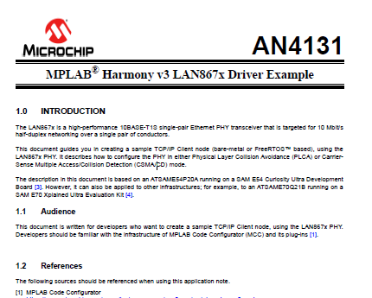
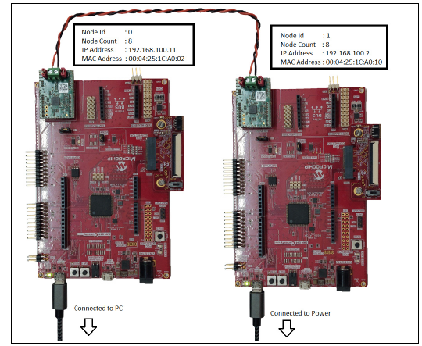
Goal of this Hands-On Training
Present a demonstration of an example of Single Pair Ethernet communication over 10BASE-T1S
Use LAN8670 RMII evaluation board with SAME54 Curiosity Ultra
Based on Application Note AN4131
Link to AN4131 is given here and is also available on LAN8670 Product Page
Notes:
The demo will show you how to build, from scratch, a project in Harmony 3 that will include the Harmony 3 TCP/IP software stack together with the driver for the 10BaseT1S PHY. Using two Microchip evaluation boards that I have with me today, I will then show you the TCP/IP communication link between the two evaluation boards which are connected to each other using a single twisted pair of wires, rather than a more usual CAT 5e or CAT 6e Ethernet cable. The evaluation boards that I am going to use today are a pair of identical boards which have the ATSAME54 32-bit Microcontroller, mounted with a 10BaseT1S PHY daughter board.
The TCP/IP stack will use the MAC module on the SAME54 to communicate over RMII with the PHY on the daughter board, which will then transmit the information over the twisted pair of wires to the PHY on the other board. This demonstration is based on an Application Note that is on the product page of the 10BaseT1S PHY, which is called LAN8670.
As part of the demonstration I am going to take you step by step through the creation of the project in Harmony 3, the configuration of the TCP/IP Stack, and the configuration of the driver for the 10BaseT1S PHY. Then we will generate the code in Harmony 3 and program each SAME54 device one at a time.

Slide 3
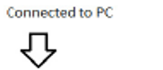
LAN8670 RMII evaluation board with SAME54 Curiosity Ultra
Ethernet Interface with RMII mounted with EVB-LAN8670-RMII to 10BASE-T1S interface card
ATSAME54P20A
On board EDBG debugger
USB Debugger Interface
Reset
Notes:
The evaluation boards are the SAME54 Curiosity Ultra boards which have a few useful development features on them. Here is a quick overview of the boards. The Microcontroller is the ATSAME54P20A which has a 32 bit Cortex M4 processor running up to 120MHz. This Microcontroller has a Layer 2 Ethernet GMAC capable of providing 10Mbps and 100Mbps data-rates with the RMII interface so that it can work with a Layer 1 Ethernet transceiver.
The MAC also provides a Medium Independent Interface Management (MIIM) bus for configuring the PHY, which will be used by the Harmony driver for the initial setup of the PHY. The evaluation board has an on-board debugging tool known as EDBG so as you will see we will be programming the SAME54 directly from the Harmony 3 application, without the need for an external, separate debugging tool. The on-board debugger is connected to the Harmony 3 application on the PC via a USB interface which can also be used to connect to the application running on the SAME54 for sending and receiving serial communication related to the TCP/IP stack. There are a number of options for providing power to this board, but this same USB interface can be used for this purpose, making it possible to use one USB interface for programming, power as well as the serial communication port. The board also features a Reset switch which we will be using as part of this application also.
You will notice that the PHY interface card does not look like the more usual Ethernet PHY that would typically be used for point-to-point Ethernet communication. Usually, the daughter board that would occupy this slot would have a 10, 100, or 1000BASE-T PHY populated on the board along with an RJ45 socket which would have a transformer integrated into it. The link would normally be provided using a CAT 5 or CAT 6 cable to another PHY, either standalone or on a switch. You will notice that this PHY is connected to the opposite board using a single unshielded twisted pair of wires, which are connected by screw connectors rather than an RJ45 socket. This is due to the fact that the LAN8670 is a 10BASE-T1S PHY which can be used to transmit information using a signal pair of unshielded twisted wires.

Slide 4
Project Setup
Step-by-Step Guide to Creating the Project

Slide 5
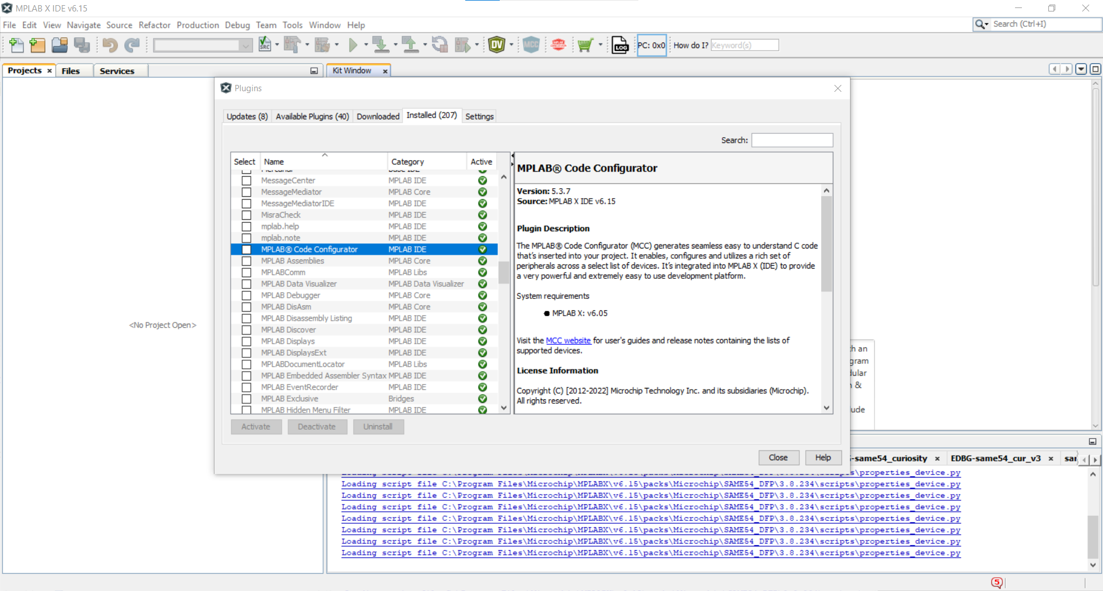
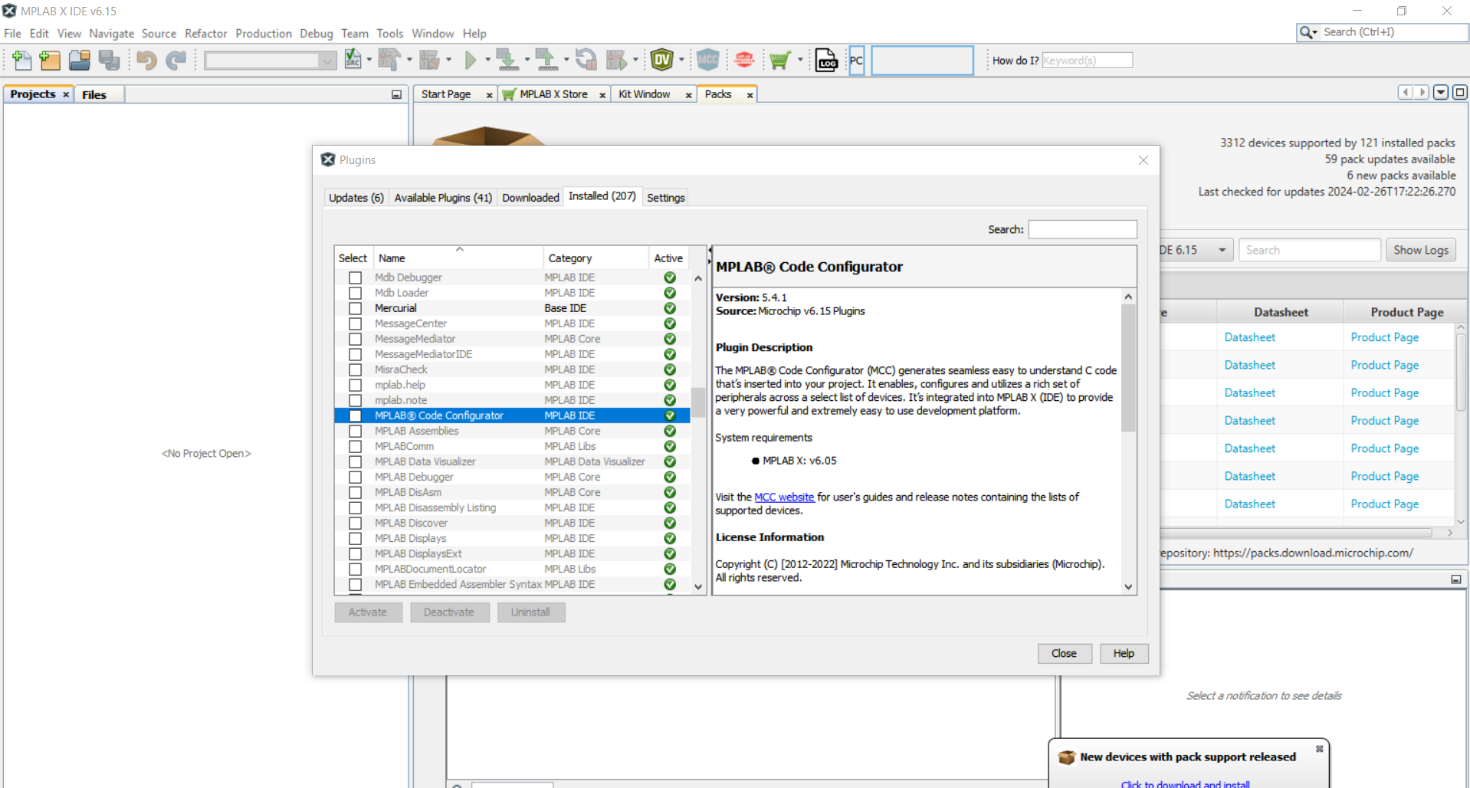
Step 1
Having opened MPLAB X IDE (See Useful Links and References) , in Tools > Plugins, check that you have MPLAB Code Configurator installed.
If it is not there, look in Available Plugins and install it from there.

Slide 6
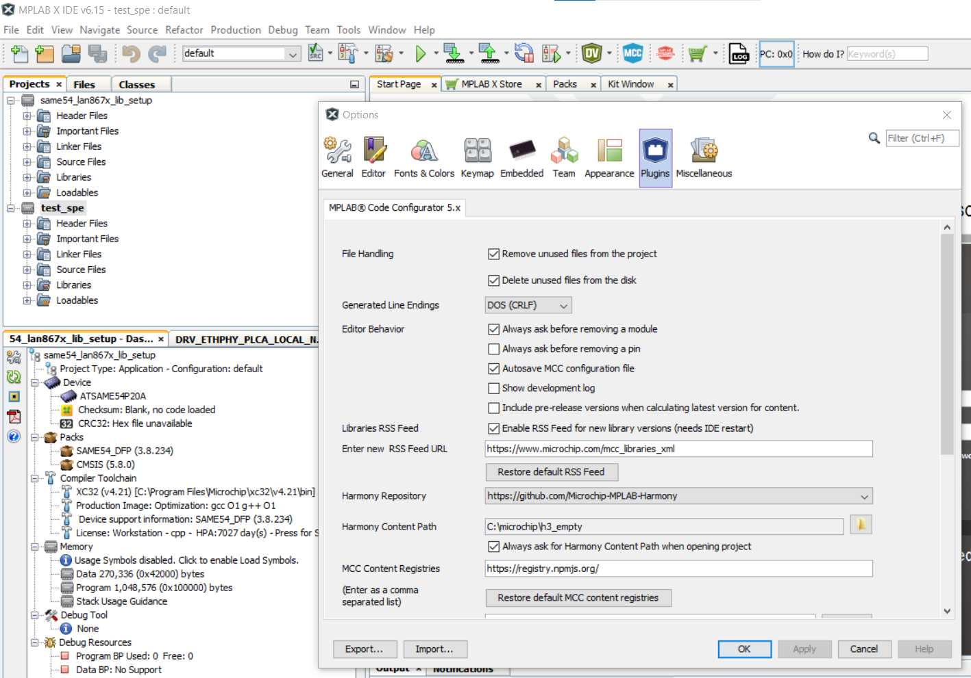
Step 2
In Tools > Options, go to the Plugins tab.
If you have not used Harmony in the past:
In your Folders on your PC you need to create an empty folder where all of the harmony libraries will be downloaded to. Having created this folder, put the folder location in the Harmony Content Path in as shown.
If you are a Harmony user:
if you have used Harmony before, you will have already created a repository for all of the libraries, and you can use this same folder for the purposes of this class.

Slide 7
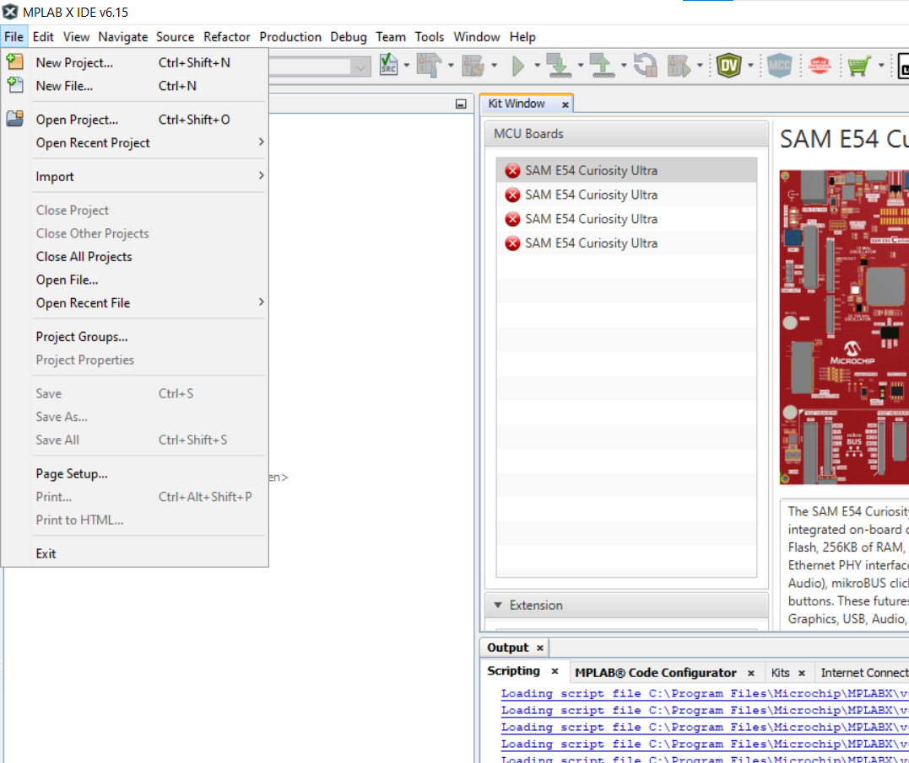
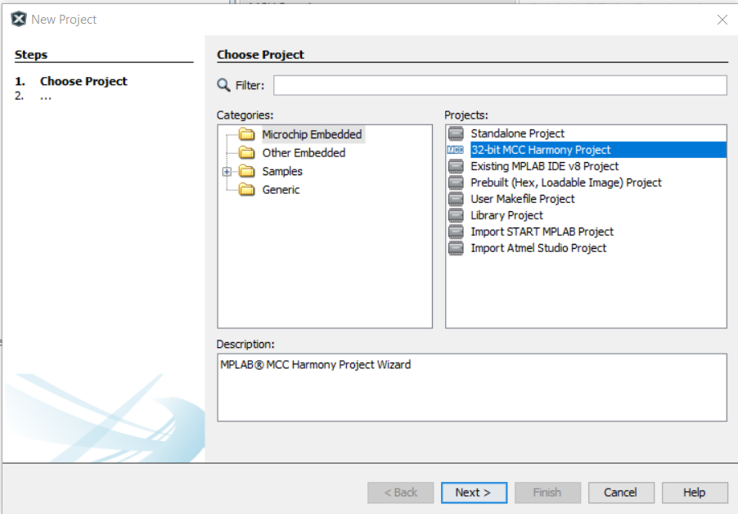
Step 3
In MPLAB X, go File > New Project…
Select 32-bit MCC Harmony Project and click Next>

Slide 8
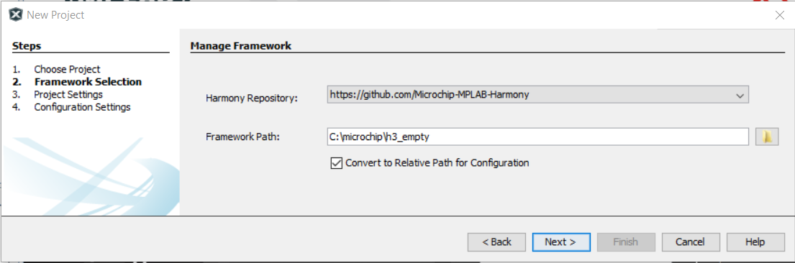
Step 4
The Framework Path needs to be the same as you specified in the Tools>Options>Plugins Harmony Content Path in the Step 2.

Slide 9
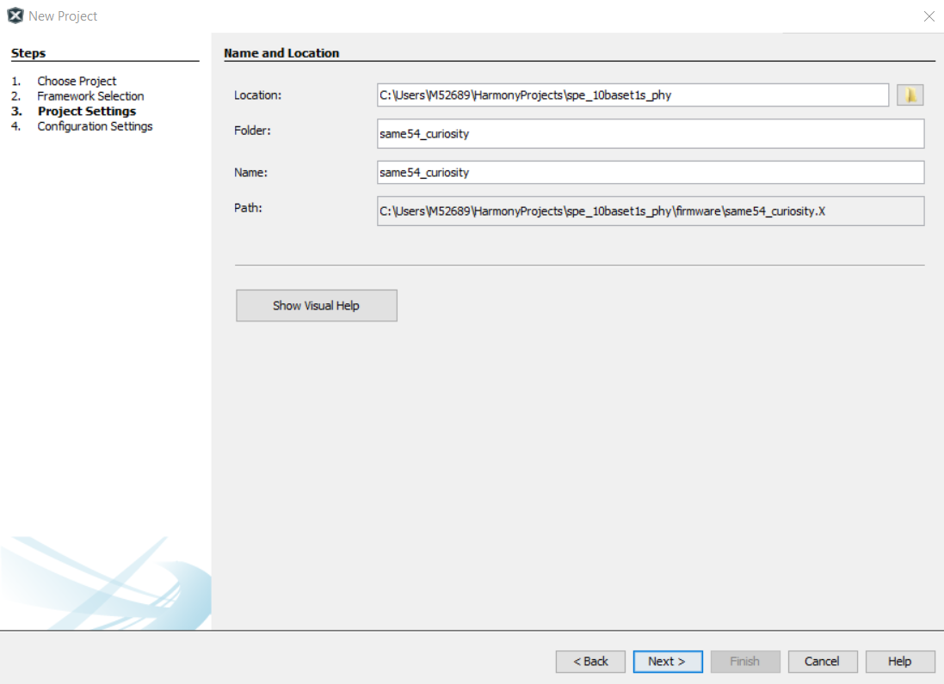
Step 5
Specify the Location, Folder and Name of your project (Tip – Show Visual Help is useful to understand the differences between these.)
Click Next >.

Slide 10
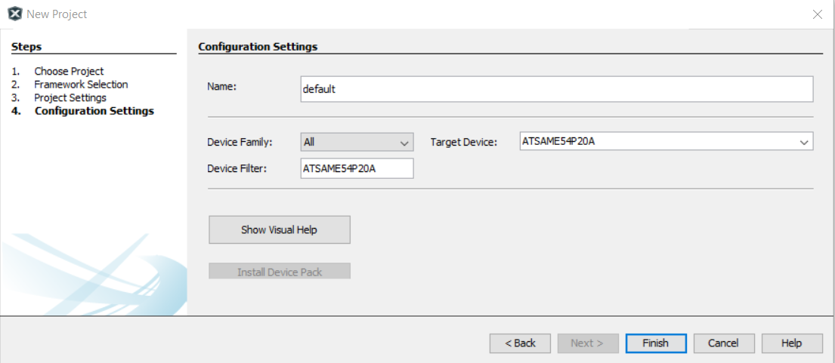
Step 6
Choose a Configuration Name (or leave it as default) and select the Device Family as ATSAM, and Target Device as ATSAME54P20A. (Tip: copy/paste ATSAME54P20A into the Device Filter and this will find the device quickly) Click Finish.

Slide 11
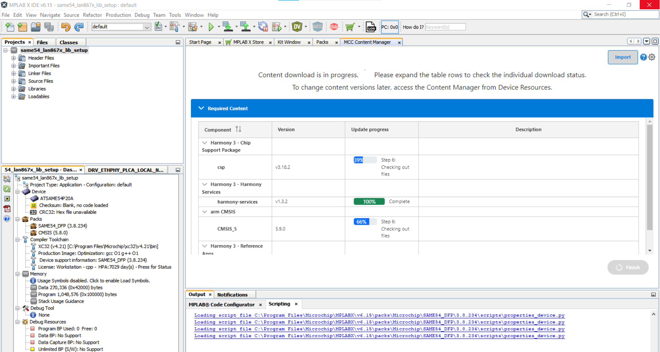
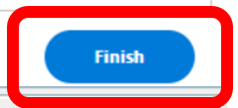
Download the Essential Libraries
If you have not downloaded the libraries before now, you will see a window like this, and you can click Finish to download the essential libraries for the device you have selected to use.

Slide 12
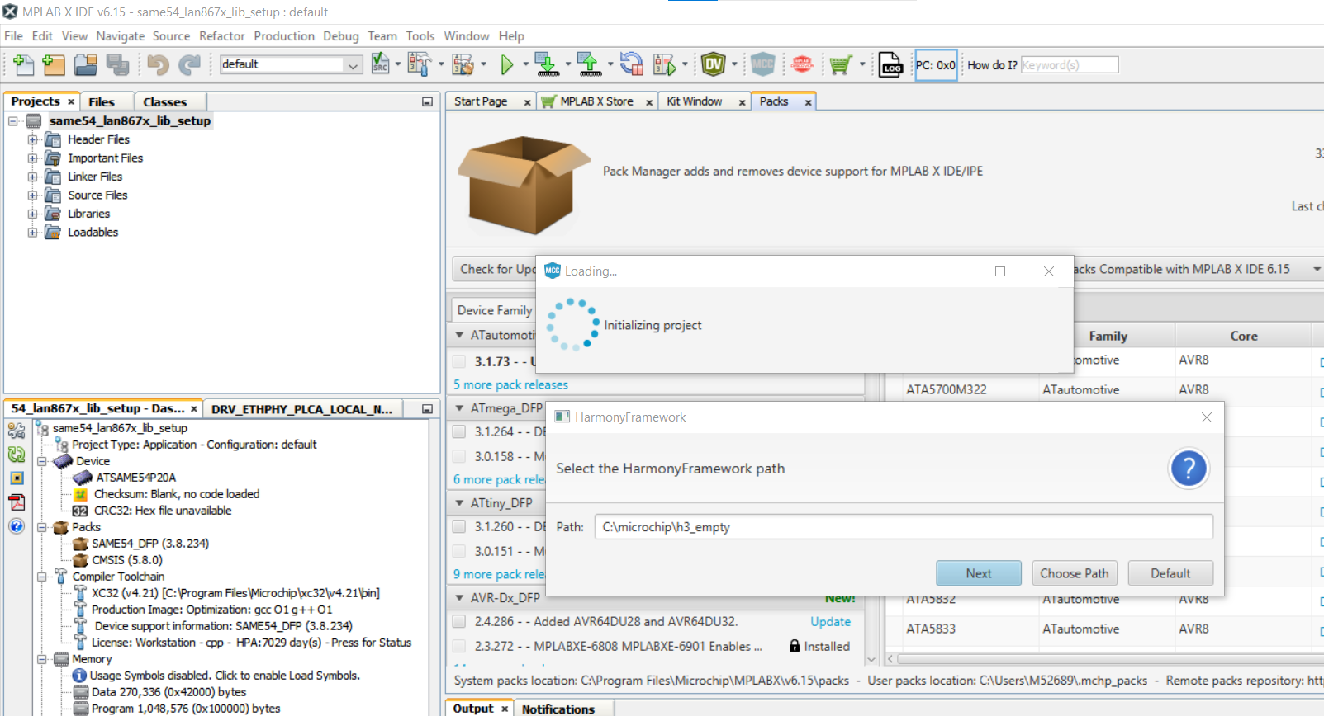
Approve the Harmony Framework Path

Slide 13
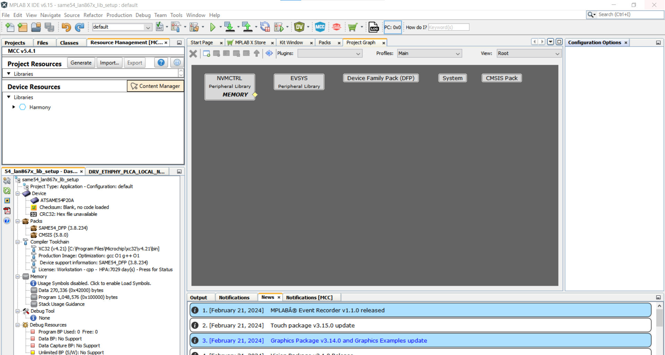
Open the Content Manager

Slide 14
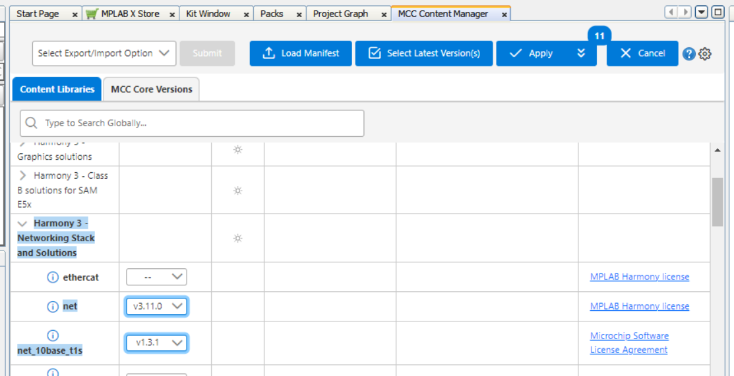
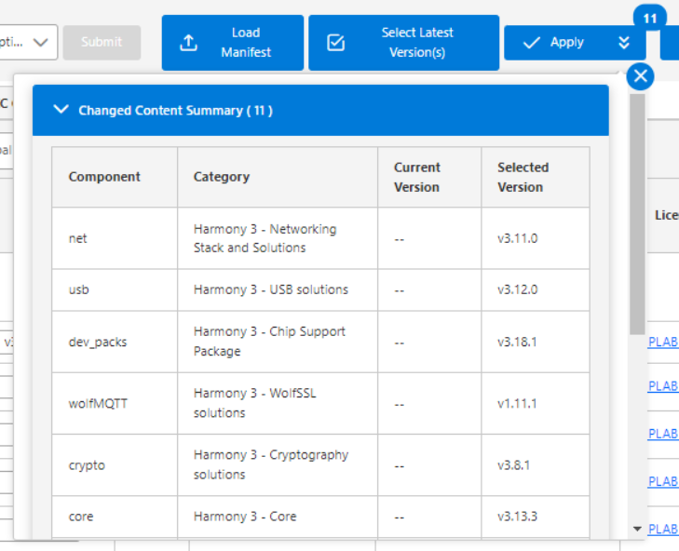
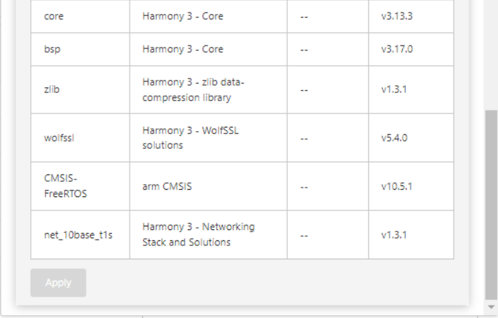
Select the Latest Versions of the Required Libraries
Select the latest versions for net and net_10base_t1s libraries.
Then you can see the libraries that these depend on – so these will be automatically included.
Select Apply to start the download for the libraries, this could take 30-60 minutes

Slide 15
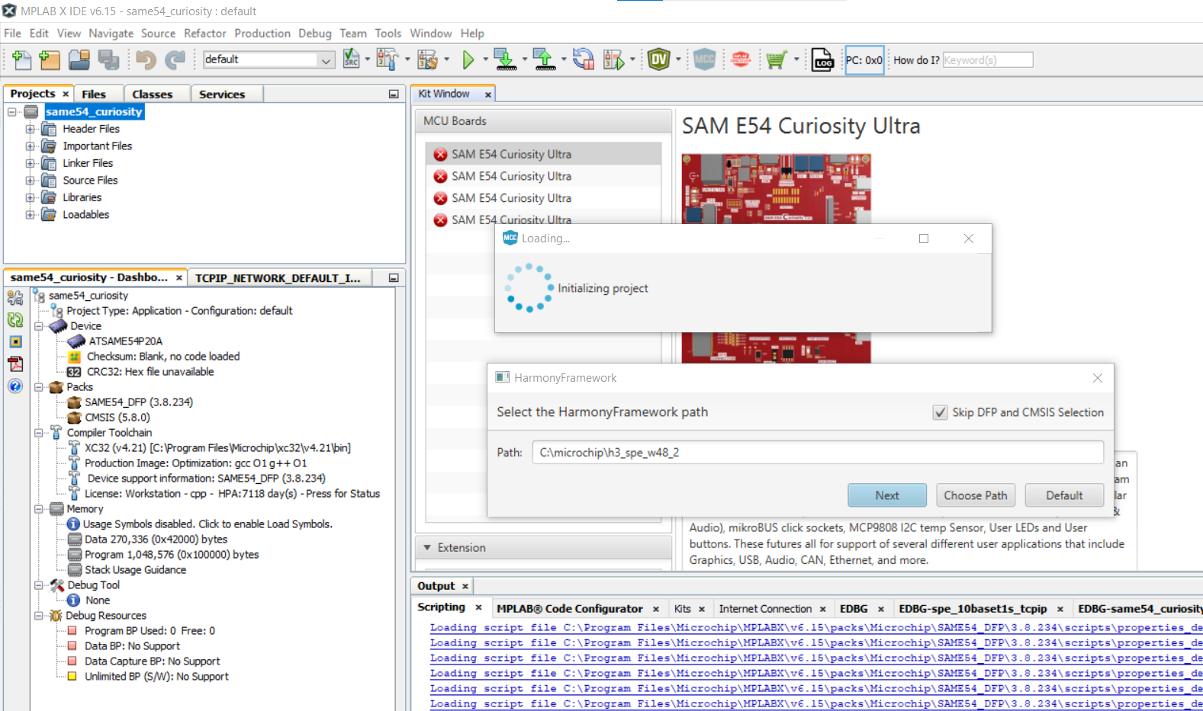

Step 11
Once the libraries have downloaded, the project should open in MCC automatically. If it doesn’t, then you can open MCC by clicking on the MCC button at the top of the MPLAB X window.
If the Harmony Framework path box appears, make sure that it has the same path that you specified originally for the project and for the Plugin Options in the earlier steps.

Slide 16
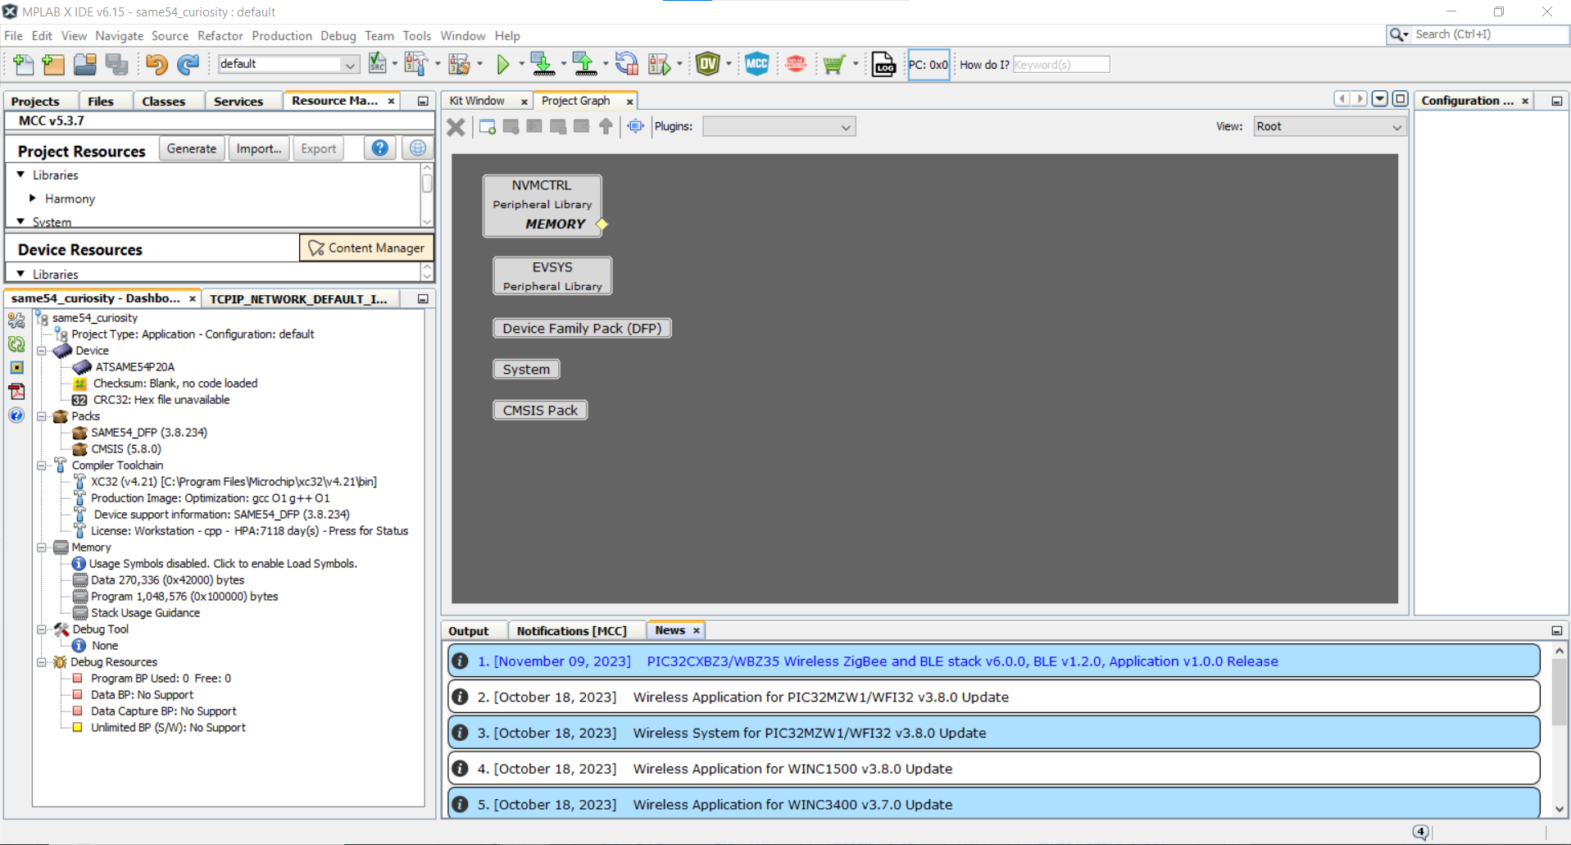
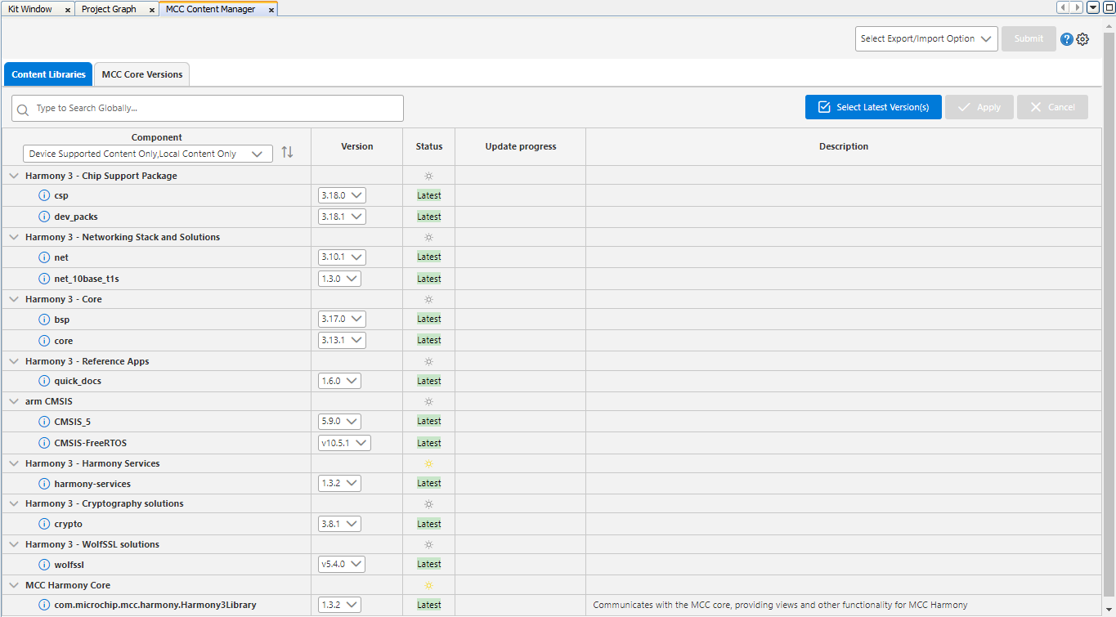
Step 12
Click on the “x” to close this view.
Open the Content Manager and view the packages that have been downloaded.
Tips:
Select Local Content so that you view just the libraries that you have downloaded rather than everything that was available for download
Use the down arrows beside the package headings to view all of the packages and versions

Slide 17
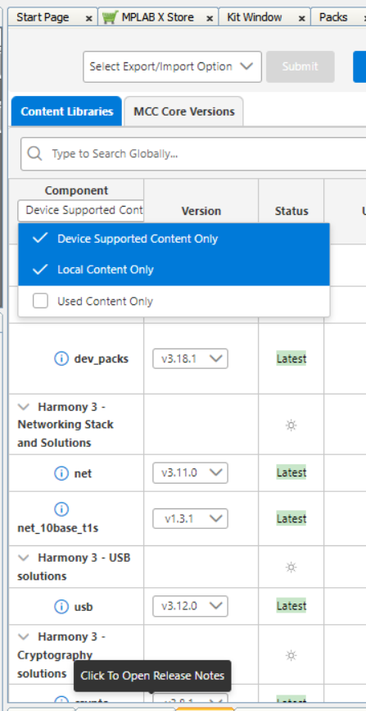
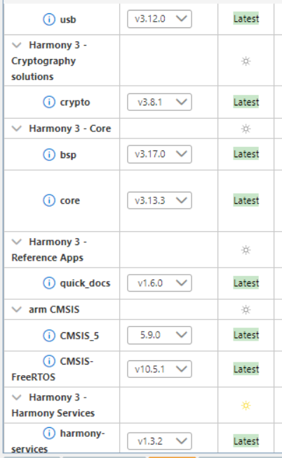
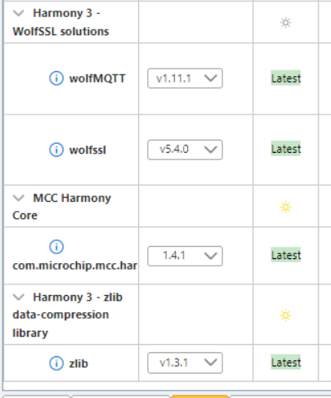
Check the libraries that have been downloaded

Slide 18
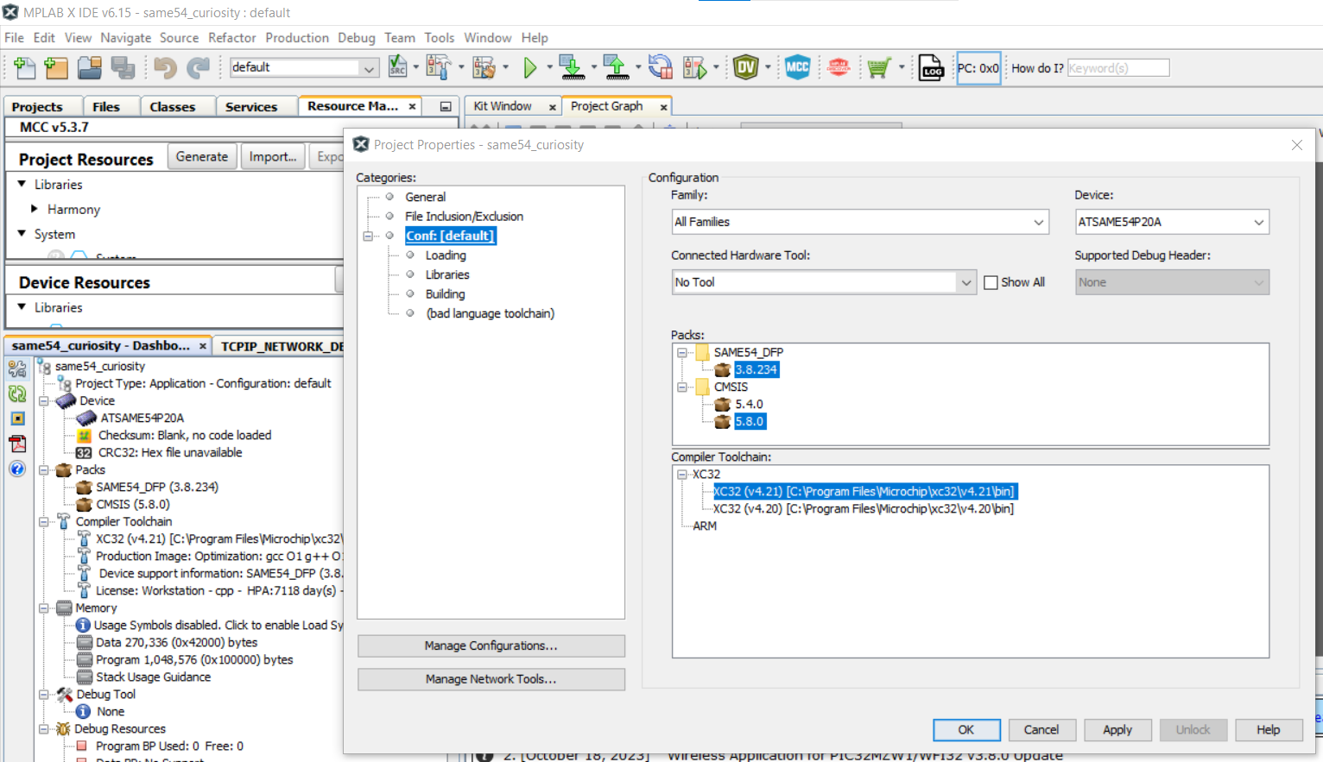
Step 13
Check that you have the most up-to-date Device Pack and that your XC32 compiler is included in the project. To do this, open the Project Properties and view the Packs and Compiler Toolchain.

Slide 19
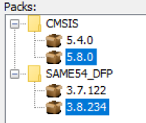
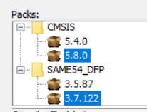
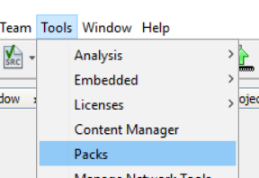
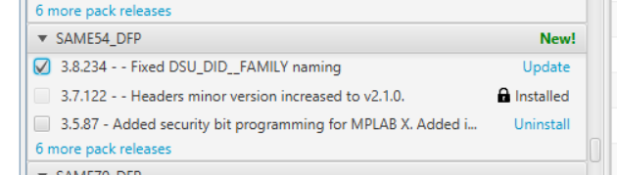
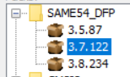
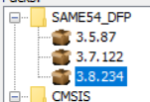
Step 13 (contd) Device Pack Update
If you don’t have the most up-to-date Device Pack installed, here is how to update it:
For example, if instead of 3.8.234,
you have 3.7.122
Go to Tools > Packs and search for “SAME54_DFP” and select the most recent version, and Update
Afterwards, change the version in the Project Properties
Open Project Properties
to change the version
->

Slide 20
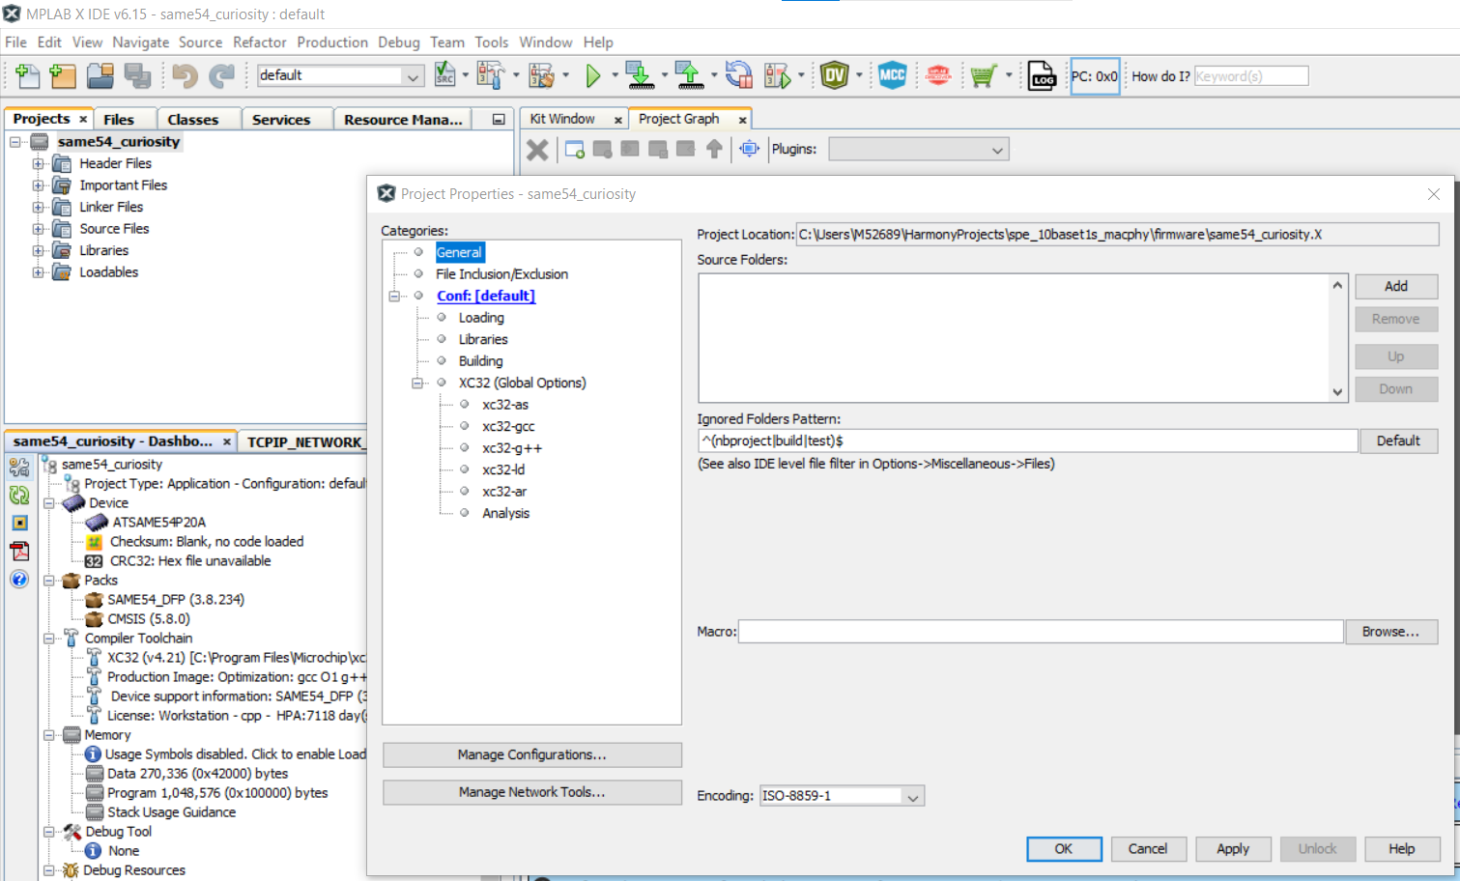
Step 14
Now you are all set! Take note of the location of your project, you can do this by opening the Project Properties and going to the General category, and viewing the Project Location.
You will be able to close the project now, and re-open when you need it.

Slide 21
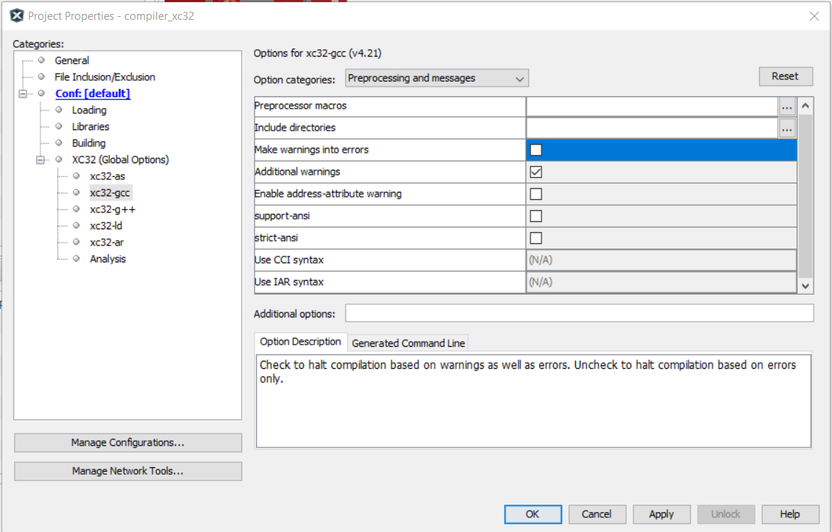
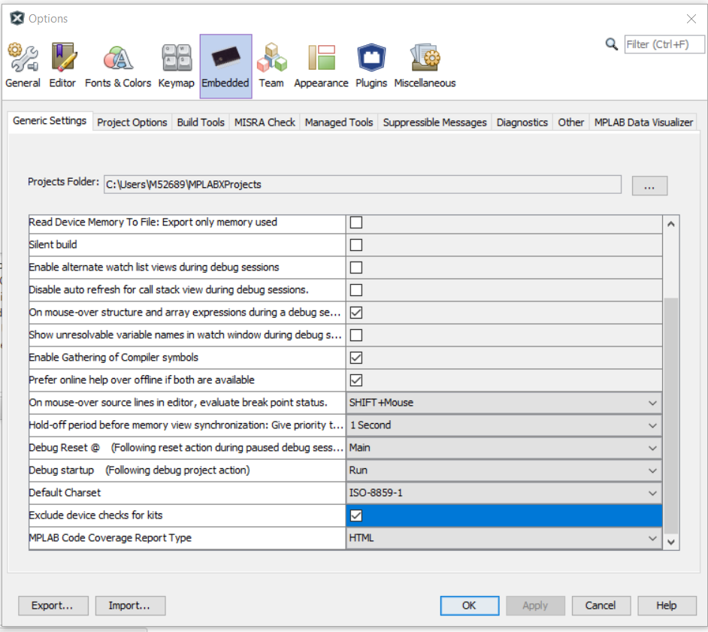
Additional settings that could cause problems!
In Project Properties, uncheck “Make warnings into errors”
In Options > Embedded, check “Exclude device checks for kits”

Slide 22
Configuring the Project in MCC

Slide 23
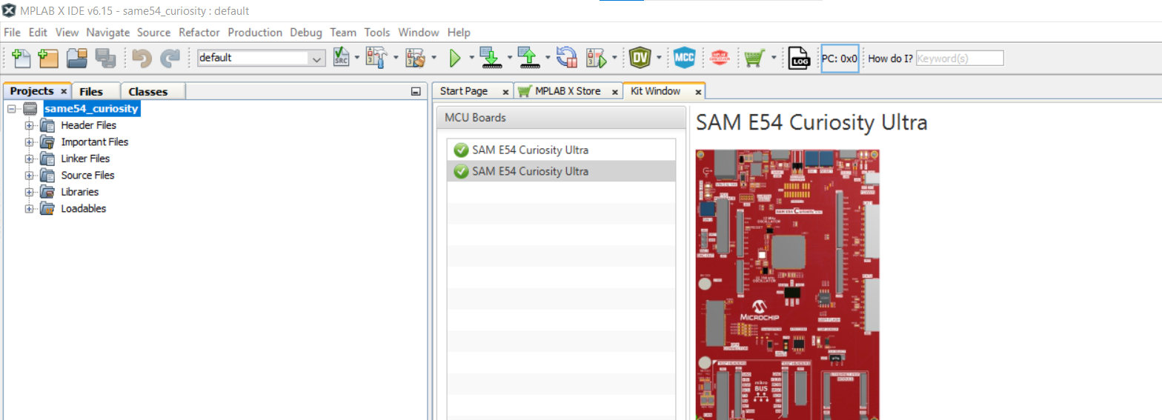
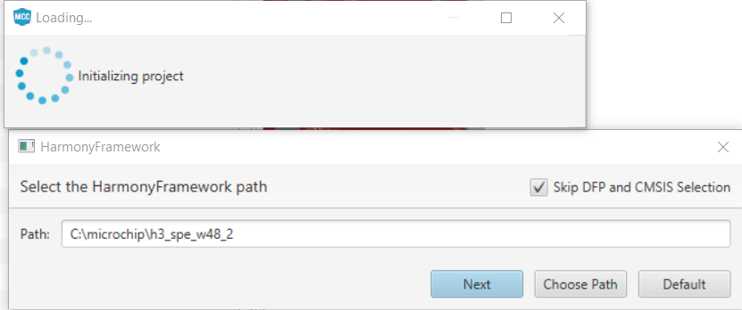
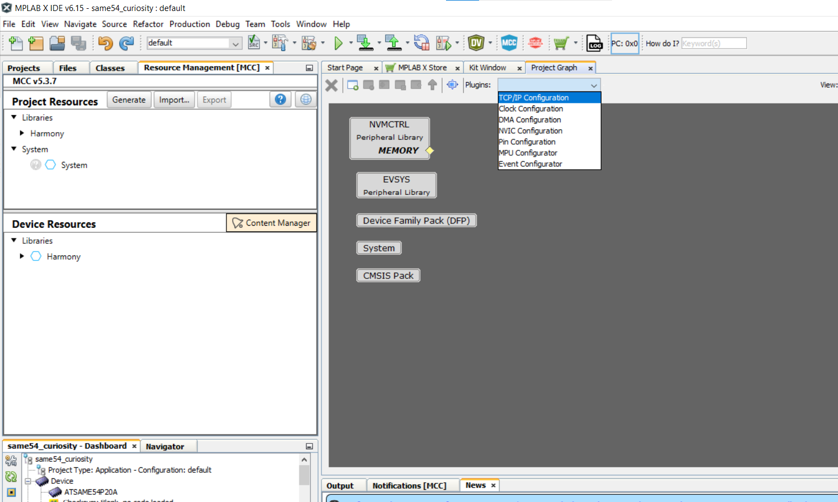
Open MCC and the TCP/IP Configuration Tool
To open (or close) MCC, click on the blue MCC button
Make sure to check that the Harmony Framework Path is correct in the popup box, as per Step 11
Start by opening the TCP/IP Configuration Plugin
Notes:
One thing that's a good to draw your attention to at this point looking at IDE is that you can see there's something called a kit window here and two MCU boards are listed, this is quite nice because it's picked up the model of the boards that I actually do have connected right now. This is like a way of checking the connectivity between the hardware that I've got and the application.
Show configuration Options and Project Properties.

Slide 24
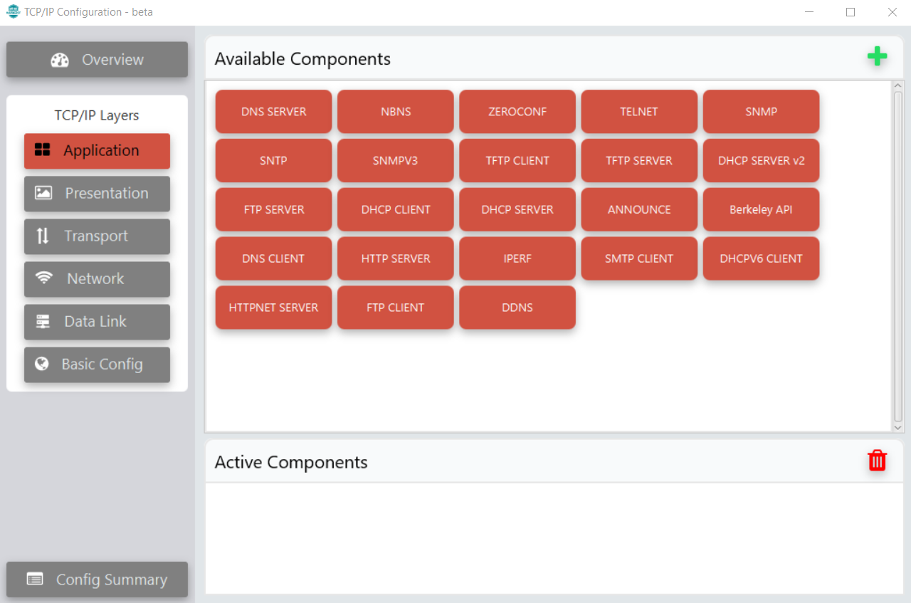
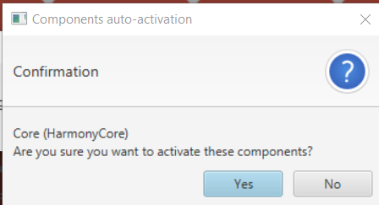
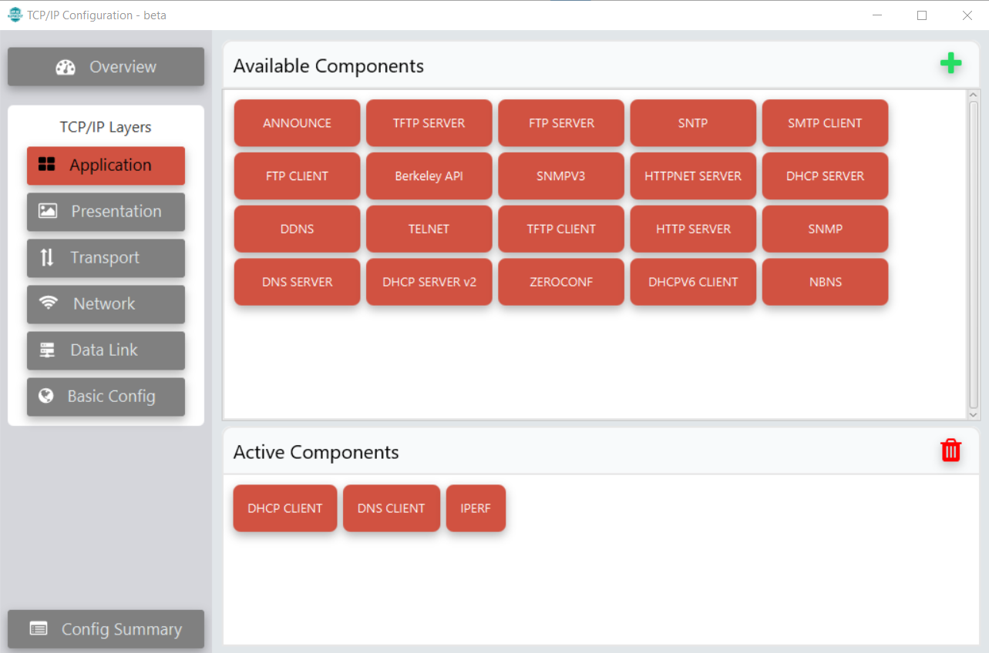
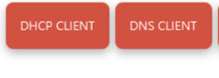
TCP/IP: Application Layer
In the TCP/IP Configuration tool, in the Application Layer, Select IPERF and click +
Click Yes to activate the Harmony Core component, and No for FreeRTOS (not needed for this demo)
Also add DNS CLIENT and DHCP CLIENT
Notes:
The first application we're going to select is to provide DHCP functionality. DHCP stands for Dynamic Host Configuration Protocol, and it allows your embedded system to get an IP address on the ethernet network to which it is connected. The TCP/IP stack supports both a server and a client configuration. In this example we are going to use the client configuration, which means that if the device is connected to a DHCP server then it will be able to accept an IP address from the server.
Note when we click DHCP client that it's not a component that just works on it’s own. DHCP client works with a number of different harmony components, so they all work together, offering services to each other and between the drivers, the middleware and the application. What we need to do is we're going to accept almost all of these queries, because we're going to need to activate the components.
We’re going to accept Harmony Core. The only one we're not going to accept is FreeRTOS. Now it is absolutely fine to use FreeRTOS in your design if you wish. I’m leaving it out for the sake of simplicity, and to save on the time taken for generating the code and programming the device etc. It should work just fine if you use for your application, but I'm going to click no for this because it's not necessary in order for this demo to work.
The next thing we're going to use is DNS client, DNS stands for domain name system and translates a website URL name to an IP address. The stack DNS is supported with both server and client, but we will just include the client configuration in this example.
The next thing we're going to add, and this is the last thing we're going to add, is just an application to enable us to monitor network bandwidth. We'll use iperf for that.

Slide 25
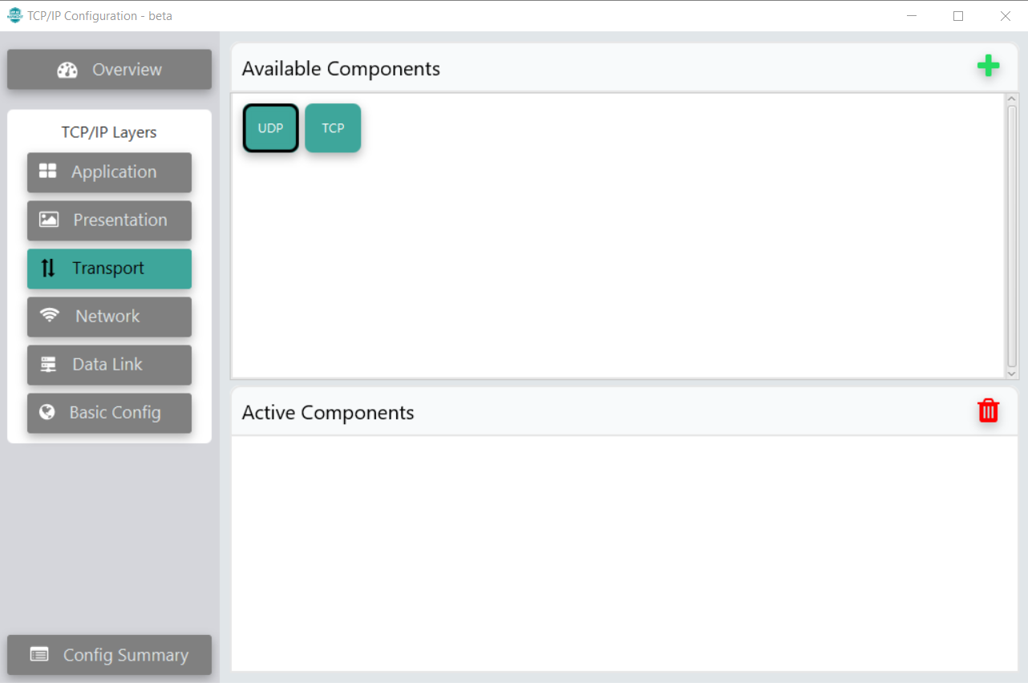
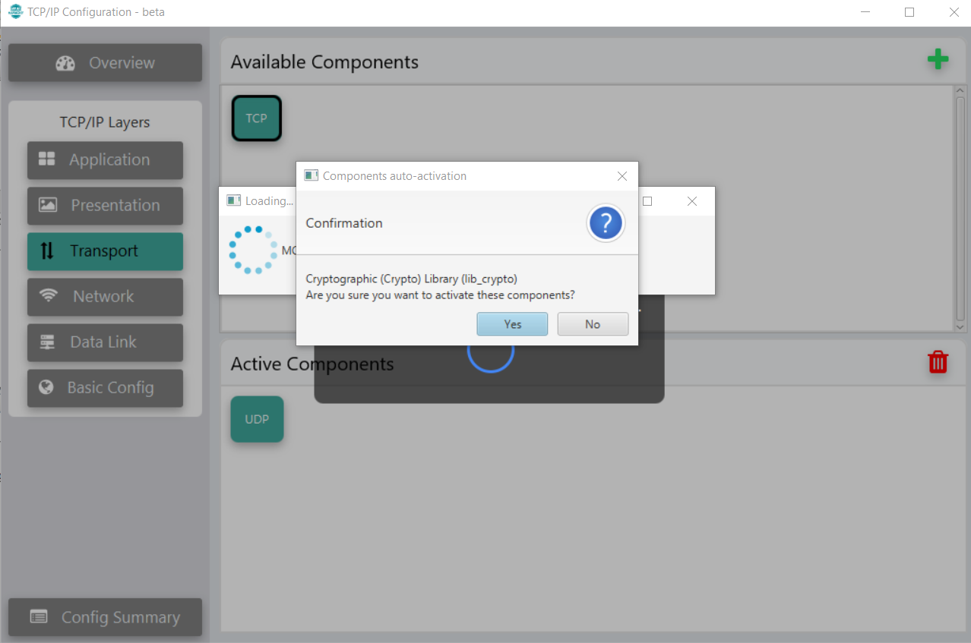
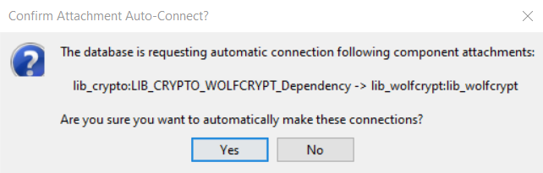
TCP/IP: Transport Layer
In the Transport Layer, add the UDP Component in the same way
Add the TCP Component, which needs the Crypto library and the WolfSSL libraries, click Yes to add these
Note: this pop-up sometimes is hidden behind the various MPLABX windows, you may not see it until a later point, just make sure to click Yes when it appears

Slide 26
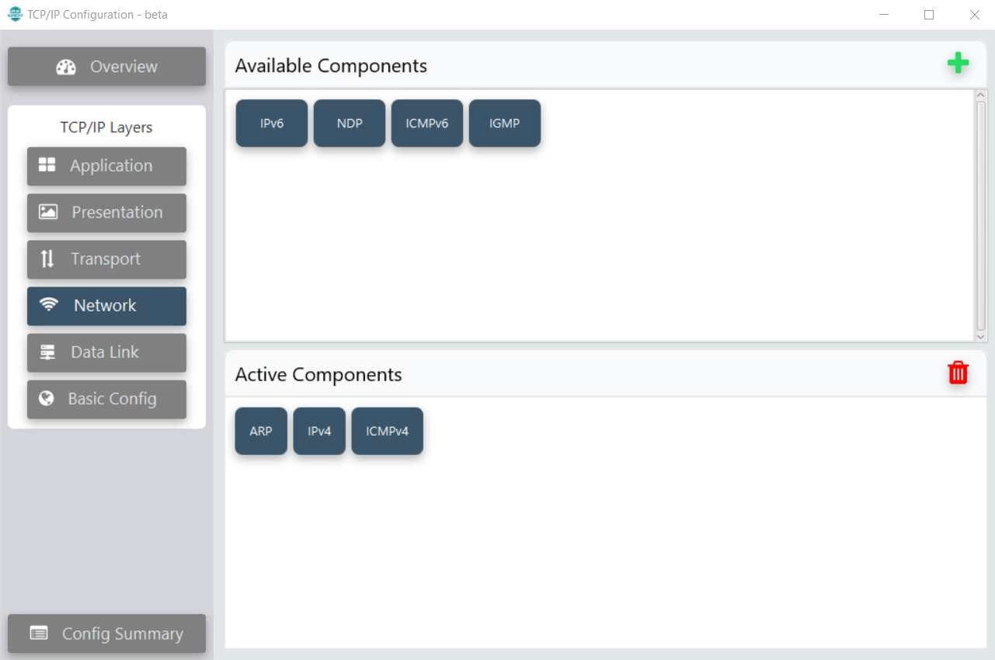
TCP/IP: Network Layer
In the Network Layer, add the ARP, IPv4 and ICMPv4 components
Notes:
We’re going to need ICMP support for this demo because we want to be able to use a ping between the two boards, that's how we're going to test the communication.
We want to add IPv4 and Address Resolution Protocol.

Slide 27
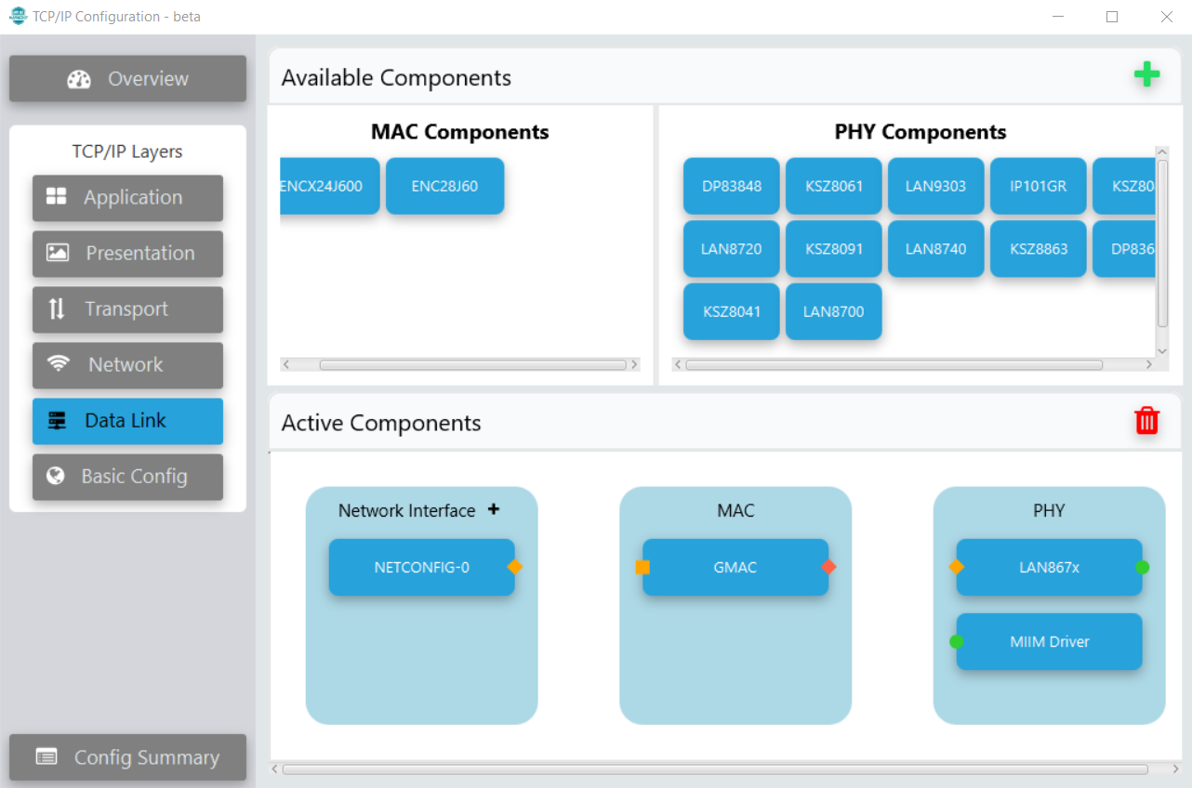
TCP/IP: Data Link Layer
In the Data Link Layer, add the GMAC component, the LAN867x and MIIM Driver components
Click the “+” beside Network Interface to add the NETCONFIG-0 component
Notes:
Going back to the TCP IP stack, we'll go to the driver layer now.
I'll double click the driver layer to bring us into there and we're going to add the driver for the Ethernet MAC. The driver for the Ethernet Mac on the SAM devices is called the GMAC. We are going to tick to include the GMAC and then we will say yes to add the component. This is going to add the GMAC as a component here.
The next thing we need to do is add the driver for the PHY. Going into PHY drivers, we need to find the driver for the LAN8670, which is the PHY that we're using. We're just going to click here to include that.
What that will include is the component for the driver as well as the management interface. And for the driver, so we'll click yes for both of those.

Slide 28
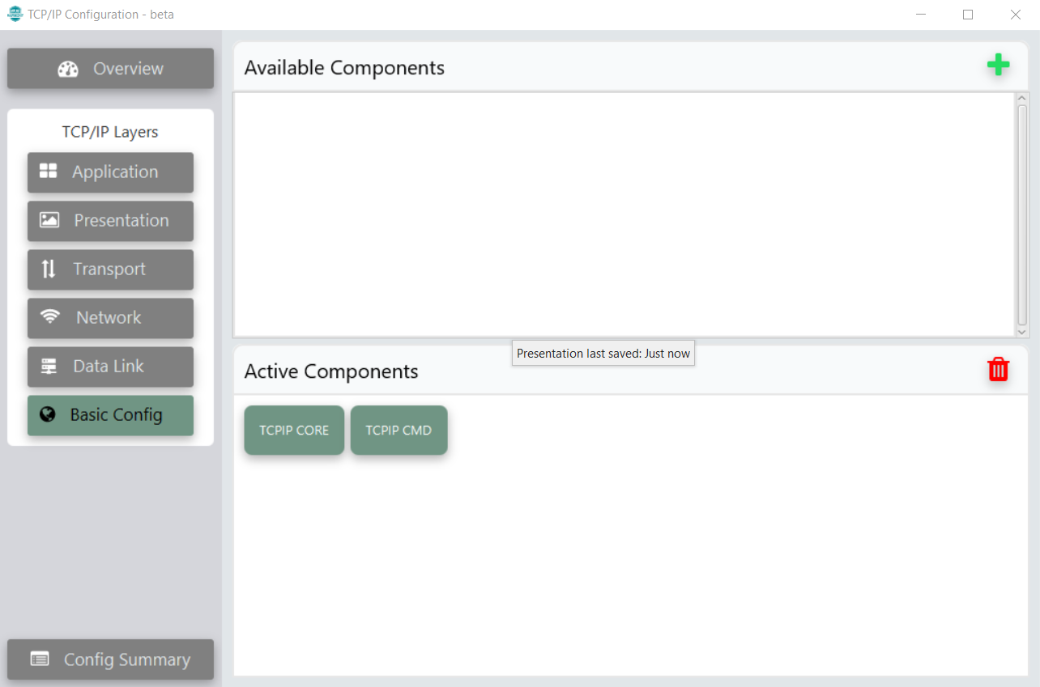
TCP/IP: Basic Config
In Basic Config, the TCPIP Core is there already
Add the TCPIP CMD component

Slide 29
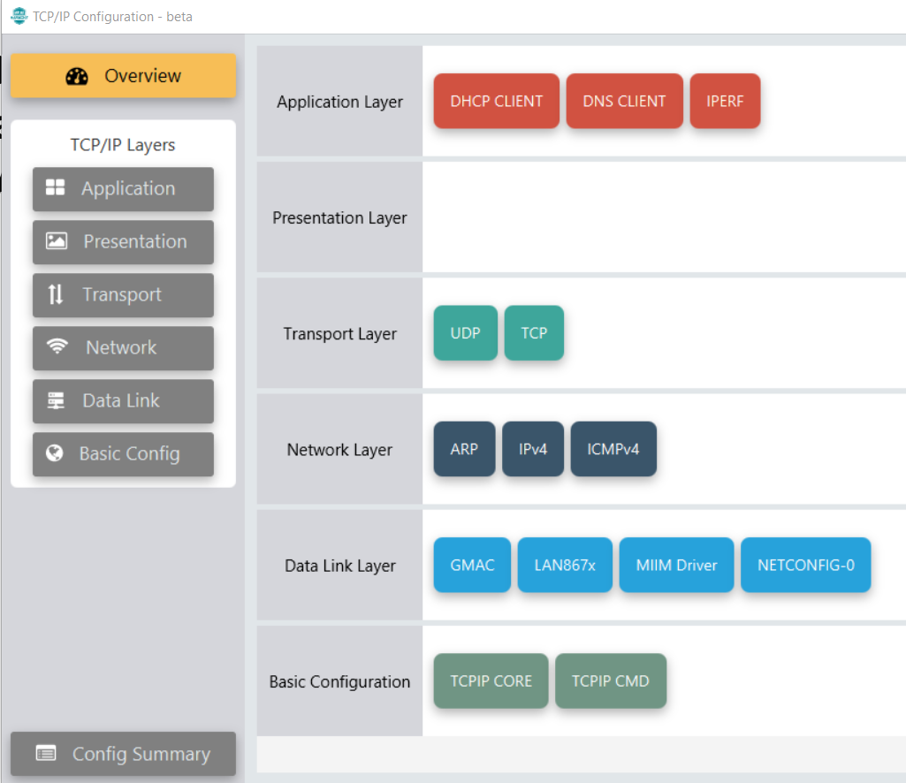
Overview
The Overview of the TCP/IP Configurator should now be populated with the necessary components for the stack

Slide 30
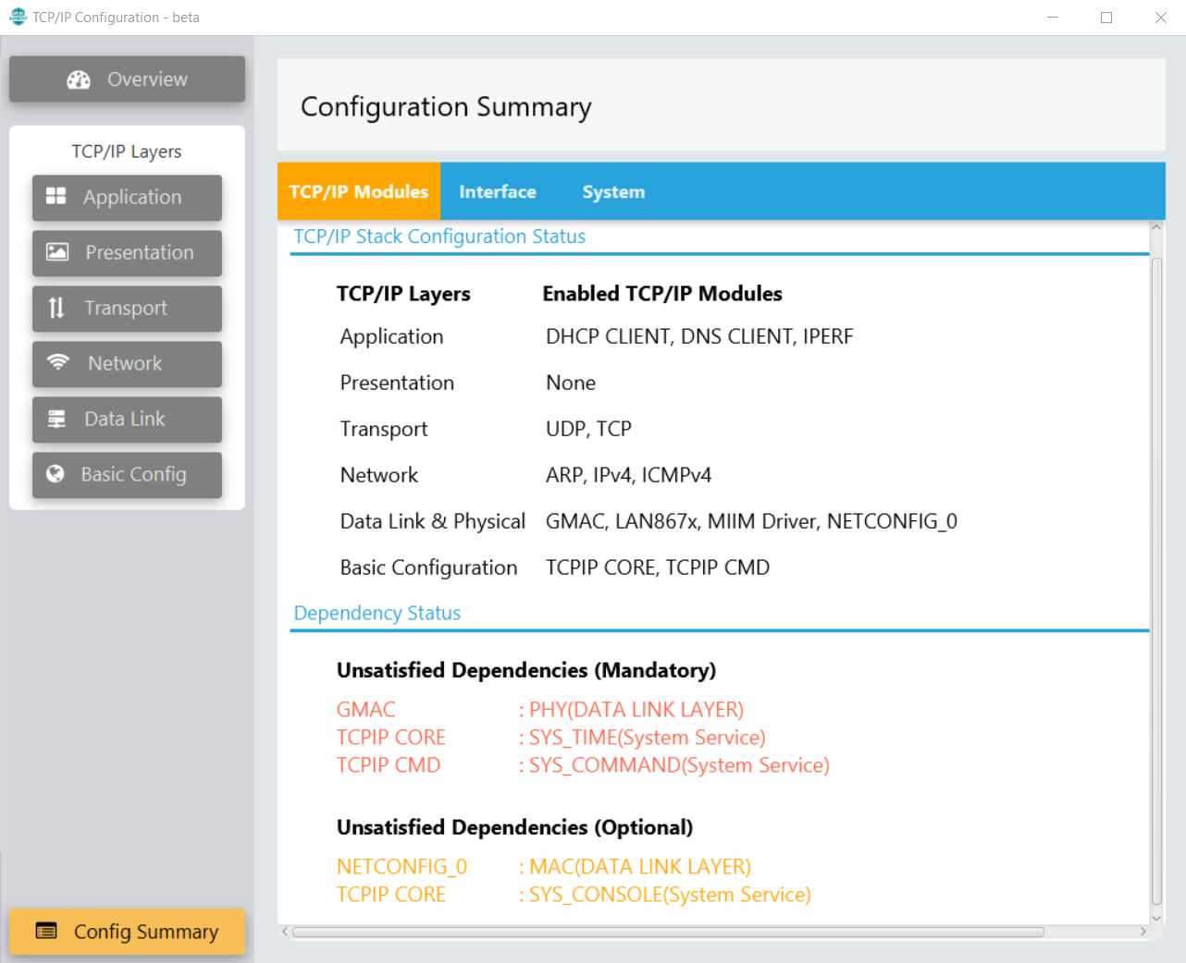
Config Summary
Check the Config Summary to see what has been included
Note the Unsatisfied Dependencies, these are elements of the project that the components require in order to work, and they must be satisfied.

Slide 31

TCP/IP Data Link Dependencies
In the Data Link Layer, connect NETCONFIG-0 to GMAC
Connect GMAC to LAN867x PHY driver
To do these connections, simply use the mouse to “draw” a line between the red/orange dots on the components

Slide 32
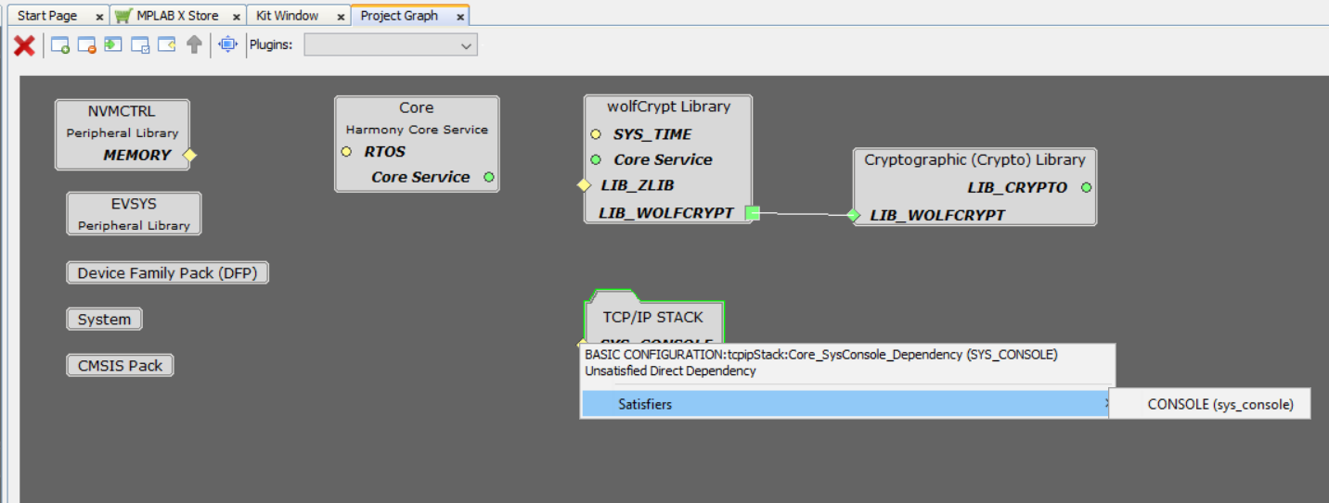

System Console
Return to the Project Graph, you should see the TCP/IP Stack and the WolfCrypt components. (You may need to accept the Wolfcrypt dependency confirmation popup at this point if you have not already)
Use the Project Graph to add the System Console to the project
Do this by right-clicking on the yellow diamond “SYS_CONSOLE” and select Satisfiers > CONSOLE (sys_console)
The System Service Console is now added to the project graph
This Console needs a UART instance, right click on the yellow diamond labelled “UART” and select SERCOM1
Notes:
What is noticeable on the project graph is that each component has these little buttons on the sides. The buttons are all different colors and some of the buttons are circles and some of the buttons are diamonds. This is how the different components of the project graph connect to each other and how connectivity is indicated between the components and the project graph.
Towards the left-side edge of the component these buttons indicate the dependency of the component. Having a dependency means, the component is dependent on some other component for its correct functionality.
Towards the right-side edge of the component these buttons indicate the capability of the component . Having capability means the component is exposing its features to other components.
The color coding of dependency and capability
The green color of the box indicates a dependency/capability is already satisfied.
The red color of the box indicates it needs to be satisfied.
The yellow color of the box indicates it is optional to satisfy this dependency. For example, the Core component shows a Implied dependency for RTOS that is not satisfied, since this application without an RTOS.

Slide 33


TIME System Service
Add the TIME System Service from the Device Resources window, which is located in Libraries > Harmony > System Services
Do this by clicking on the “+” beside the TIME system service
Right click on the yellow diamond labelled “TMR” and select TC0 as the timer for the project (the diamond will turn green when TC0 is added)

Slide 34


COMMAND and DEBUG
Add the COMMAND (sys_command) and DEBUG (sys_debug) as Consumers for the Console System Service, along with the TCP/IP Stack.
Do this by right clicking on the green square labelled “SYS_CONSOLE” and selecting these components, one at a time
The TCP/IP Config Summary should now have no unsatisfied dependencies
Close the TCP/IP Configuration Tool at this point

Slide 35

Project Graph
The project graph should now contain all of the necessary components

Slide 36

Application Layer Settings
In the Application Layer, Select the IPERF component, and change the speed to 10Mbps
Notes:
Set up IPERF for the 10Mbps speed as used by the PHY.

Slide 37

Network Layer Settings
In the Network Layer, for the ICMPv4 component, select to Use ICMPv4 Client, and Enable ICMP Client Console Commands
Notes:
Next we’re going to configure ICMP4 for the Ping command, so we're going to click on it here.
We’ll click to include the client, and we’ll enable ICMP Client console command to facilitate the ping command so we're going to need to enable that we can leave everything else as is.

Slide 38


Data Link Layer Settings
In the Data Link Layer, click on the GMAC component and set the Ethernet Connection Flags as shown
Click on the LAN867x PHY Layer component and select the Advanced Settings to use PLCA, leave the other settings as is
Notes:
Next we set up the the GMAC so that it works correctly for for the PLCA system that we've got.
10BASET1S is a 10 megabit per second half duplex communication standard and it doesn't use auto negotiation, so we're going to Click to configure all of this now.
There is on the board an RMII connection between the PHY daughter board, and the MAC on the MCU, so we can leave this as is.
Next, we’ll configure the 10BASET1S driver.
We need to use the advanced settings here - and we're going to select PLCA in the driver, you have the option to use CSMA/CD for the driver, though you usually wouldn't for 10BASET1S. We will select to use PLCA here and let's just have a quick check of the PLCA settings.
The Local Node ID is 0 and the Node Count is 8. If we leave these two settings as is, we're telling this SAM device that it’s PHY is going to be the coordinator ( you might remember from the slides that the coordinator is Node 0 ) and that there are eight nodes on this system. In reality, there are only two nodes on the system that I have here to show you, but we're going to leave this Node Count as eight. All that will do is cause a very small amount of redundancy in the system, but it means that we can come along later and add more nodes to the system without having to reconfigure.
For this demo we will not use Max Burst Count for this demo. If we did, we would enable the additional frames by increasing this Max Burst Count number, we don't need to worry about the Burst Timer either.
That's the the PHY configured.

Slide 39

Network Configuration
Observe the network configuration settings in the NETCONFIG component, change the MAC address and IP Address.
Each of the two boards will need distinct MAC addresses
They will also need distinct IP Addresses which will need to be on the same network subnet with distinct node numbers, here “26” is used
Notes:
The next thing we want to do is inspect the MAC. The MAC settings are here in the Net Config and we’ll look at the MAC address and the IP address. This MAC address is not a unique MAC address, it is just one that's default here in Harmony. We're just going to use it for the purposes of this demo. The same is for the IP Address, this is just the default Harmony one, and we're just going to use it here for the purposes of this demo.
We have two boards to program, and these two boards must be unique with respect to each other in terms of MAC address and IP address. We would need to come back and change these when we program the second board. Another thing we would need to change for the second board is the PLCA Node ID. We we saw that the PLCA node ID for the first device is going to be 0, so it is going to be the coordinator. There must be only one single coordinator on a PLCA system, so we’ll be setting up the second board to have a Node ID of 1.

Slide 40


SERCOM Configuration
In the Root layer of the Project Graph, configure SERCOM1 to increase the TX and RX Ring Buffer Size to 4096
Set the Receive Pinout to:
“SERCOM PAD[1] is used for data reception”
Notes:
Between the two boards that I have, the ethernet communication is going to be across the the base T1S twisted pair link, but it can be helpful if we could communicate with the SAM device itself to get information from the TCP/IP stack, and receive any Debug messages from the project. We’re going to do that through the USB cable that we have connected to the board. However, we're not going to use the USB device CDC tool here because looking at the hardware on the evaluation board, our USB cable comes to the Embedded Debugger and then it goes to the UART pins on the device and I'm going to show you that shortly on a schematic snapshot. We’ll need a serial communication or UART peripheral here to provide for this communication. I'm going to right click on this dependency and we're going to use Serial Communication Module 1. We will need to configure this.
Firstly, you will need to configure the ring buffer size, to increase the number of messages that we can view in the serial terminal window.
Then we will need to configure the Receive pin-out, we wish to change this so that SERCOM1 PAD[1] is used for Data Reception, and this will match the module up with the hardware that we have on our board. We can leave the Transmit Pinout as is.

Slide 41

Heap Size
Select the System component, and change the Heap Size to 44960 bytes as shown
Note: if you usually use the Project Properties > XC32(Global Options) > xc32-ld settings to set the Heap Size – be careful, as this may be overwritten when you generate the code for the project – make sure to check the Project Properties before you compile the project
Notes:
The next thing we need to do is go into the System component on our graph, and change what is called a heap size. The heap size is memory for dynamically allocated variables that are used by the project and the TCP IP stack needs quite a large heap size. We go into device - Project configuration - Toolchain Selections - XC32 Global Options – Linker – General. We’ll increase our heap size to 44960 which should be large enough for the TCPIP stack.

Slide 42

Pin Configuration Tool
Open the Pin Configuration Tool in the Plugins dropdown menu
Notes:
The last thing we're going to do here is to set up our pins. We need to select the pins so that they are in accordance with the hardware that we're using. We are going to take a very quick look at the schematic for the hardware just as you would have to do for any project to see the pin connections on the board.
we can now configure our pins and to do this, we are going to use the PIN configuration tool. I’ll go into Tools and Pin Configuration.

Slide 43


Check the schematic to see the pin connections for the ethernet and UART pins (below are snapshots from Evaluation Board Schematic)
UART Pin Configuration
GMAC Pin Configuration
RMII Ethernet Signals and Configuration
UART TX and RX lines via Embedded Debugger
Notes:
Looking at some snapshots of the schematic that I've taken already, we can see that the UART signals are coming through the Embedded Debugger, these are our serial communication lines and they are going to pins PC27 and PC28 on our device.
I also took a snapshot of our Ethernet signals, and here are the pins used by the various Ethernet signals that we are going to have to match up to.

Slide 44


Pin Configuration Tool
Having checked the schematic to see the connections on the board, use the Pin Configuration Tool to set up the pins.
The Pin Settings tab is the easiest way to do this. Select the values shown for PA12, PA13, PA14, PA15, PA17, PA18, PA19, PC20, PC22 and PC23, to match with the board connections.
Set the UART connections on pins PC27 and PC28
Notes:
The first thing we're going to do is have a look at our serial communication. We said following our schematic check they the UART signals come to PC27 and PC28. Let's go and find those now. Scroll down to PC27 and PC28. We can see that they haven't been assigned to anything just yet. And when we select the serial communication 1 and 0 for these pins, what we're going to see is that the different characteristics of the pins, that we might have otherwise had to set up by hand, is automatically set for us because we have chosen the particular function for that specific pin.
Coming to the GMAC, again we've seen what the pins from the schematic.
Now another thing you can do here which is a nice feature of the PIN settings table is you can give each pin a custom name. So if you have a name that suits your project, you can you can just type it in here and that will appear on your PIN table like this. But we'll push on and we'll configure: PAS12 ,PA13, PA 14, PA15, PA 17, PA 18, PA 19, PC 20, PC22 and PC23.
PC22 and 23 are the Management interface pins. Like I mentioned already, you can see that every time I configure one of these pins the different characteristics are set automatically. These match the function required for that pin.

Slide 45

Pin Diagram
The Pin Diagram should now look as shown – the pins that are green are the ones that have been configured using the Pin Settings
Notes:
Let’s take a quick look at the PIN diagram now so you can see a few changes – we have got SERCOM1, 1 and 0 selected up at the top, and then we've got our Ethernet pads around the the side and the bottom here.

Slide 46

Generate the Code
In Resource Management[MCC], use the Generate button to create the code for the project
Notes:
We are complete with configurating and setting up our project and we're ready to generate our code. We will click on the generate code button here.
Show the ESEs some Tribals maybe?

Slide 47


Configuration.h
The Project is now populated
Check the configuration.h Header File
The PLCA settings and the Network Configuration settings can be seen in this file
Check that the PLCA settings are correct
Check that the IP Address and MAC Address are correct
These can be changed in this file if necessary
But any changes in this file will not be reflected back into the MCC Project Graph settings

Slide 48


Build the Project and Program the Device
Clean and Build the Project
Check the output of the Build to make sure it was successful, similar to what is shown.

Slide 49

Program the Node 0 Board
Connect the boards to the PC
In the Project Properties, check the Connected Hardware Tool list dropdown menu and select which board to program
This board will be the PLCA Node 0 board
Click on Apply then OK
Hint – If the SAME54 Curiosity Board you have connected to the PC is not listed, close and reopen MPLAB X

Slide 50


Program the Node 0 Board
Use Make and Program Device to program the board.
Check the output to make sure there were no errors

Slide 51



Program the Node 1 Board
In configuration.h, change the Node ID to 1 and change the MAC and IP Address so that they are distinct from the Node 0 Board
In Project Properties, change the Connected Hardware Tool to the other board
Repeat the “Make and Build Main Project” and “Make and Program Device” steps
The boards are now programmed

Slide 52


Test
Open a serial connection to both boards using the settings shown
Reset both boards using the Reset button on the board
You should see the TCP/IP Stack Initialization messages to show the stack is working
Use the “netinfo” command to show the Network Configuration
Tip – wait a few moments after resetting the boards to allow the link to establish

Slide 53

Ping test
Use the “ping” command to check the link
Hint – To run “ping” a specific number of times, use the command like this example:
ping 192.168.100.26 n 100
To stop a ping, use the command
ping stop

Slide 54

iperf
On one terminal type “iperf –s” to initiate the iperf server on that node
On the other terminal type “iperf –c 192.168.100.xx –u –b 10M –l 1418” to test the speed of the link
Try other ethernet frame length options other than 1418, such as 700 and 300 to show the reduction of the bandwidth when the length of the frame is limited in this way

Slide 55
Useful Links and References

Slide 56

For more information…
For installing the necessary software, see:
These applications can now be downloaded from here:
https://www.microchip.com/en-us/tools-resources/develop
Make sure to download XC32 Compiler version 4.21 or later (this demo uses 4.21), as well as MPLAB X v6.15.
MPLAB X v6.15 is available here: https://www.microchip.com/en-us/tools-resources/archives/mplab-ecosystem:

Slide 57



Demo Project
There is a demo project checked into the Github Harmony repository that you will have downloaded already in the net_10base_t1s library as part of the Optional Packages list during the project setup
Use File > Open Project and navigate to this library, and choose from the freertos or non-freertos versions
Note: in order to generate and compile these projects, you will still need to have downloaded the necessary packages as described in the project setup

